Slide 1

How to be a Leader
Music City Tech
Chad Green
September 6, 2019

Slide 2
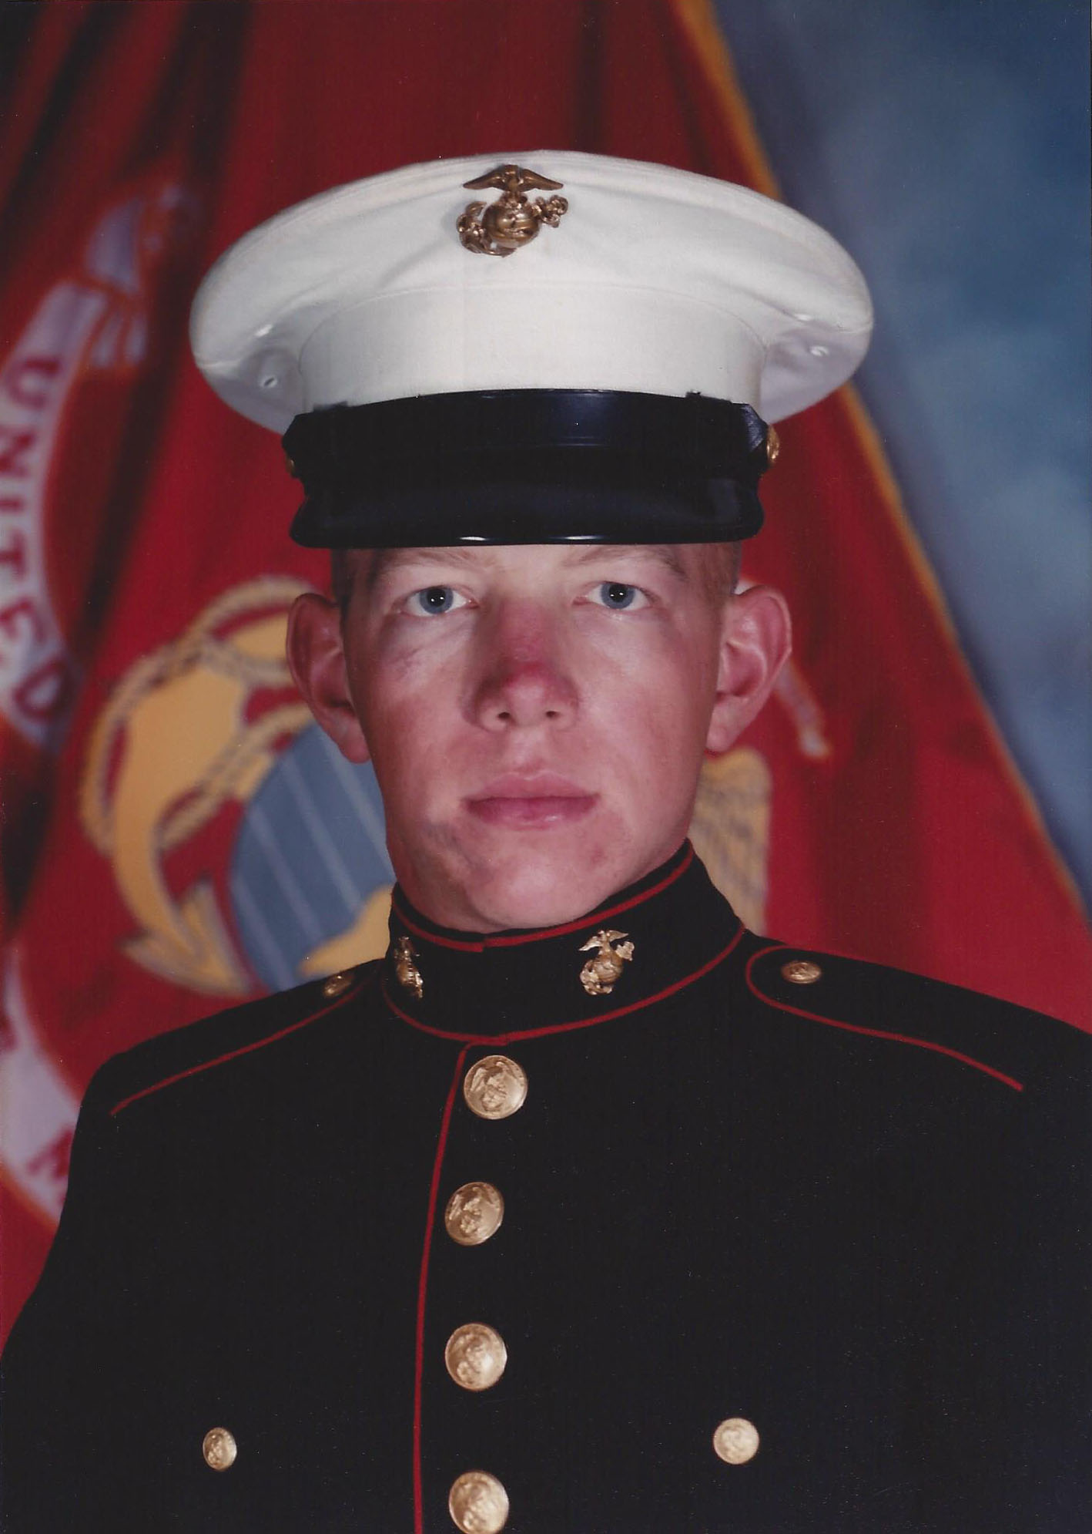

Who is Chad Green?
Director of Software Development at ScholarRx
Previous Positions
Data & Solutions Architect
Service Delivery Manager
Product Delivery Manager
Project Manager
.NET Solution Architect
Developer
Community Involvement
Code PaLOUsa Conference Chair
Louisville .NET Meetup Organizer
Louisville Tech Leaders Meetup Organizer
Louisville Tech Ladies Co-Organizer
United States Marine Corps Veteran
→ chadgreen@chadgreen.com
 chadgreen.com
 @ChadGreen
 ChadwickEGreen

Slide 3
Leadership is more than leading
The power or ability to lead other people
The sum of those qualities of intellect, human understanding, and moral character that enables a person to inspire and controla group of people successfully

Slide 4


Slide 5

Justice
Fair and Consistent – Be honest with yourself about decisions. Avoid favoritism. Treat all people, and things equally.

Slide 6
Justice
Be honest with yourself
Be aware of counter-productive prejudices
Listen to all sides of an issue
Avoid favoritism
Apply rewards and reprimands consistently
Be fair at all times

Slide 7

Judgment
Good Judgement – Do not make rash decisions. Handle problems with a common sense attitude

Slide 8
Judgment
Do not yield to impulse
Visualize the situation from another’s perspective
When in doubt, seek good counsel
Approach problems with common sense attitude

Slide 9

Dependability
Reliable – Be on time, avoid making excuses, and handle every task to be the best of your ability.

Slide 10
Dependability
Being on time
Accomplishing your assigned tasks
Build a reputation for keeping your word
Demonstrating loyalty
Notes:
Demonstrating loyalty
Speak positively about your leader
Speak only with those who have the authority to represent your concern
Build unity rather than a personal following
Avoid negative body language
Work hard and go the extra mile
Express gratitude for leader’s positive characteristics

Slide 11

Initiative
Take initiative – Stay alert. Be aware of things that need to be done and then to do them without having to be told.

Slide 12
Initiative
Be aware of things that need to be done and do them without being told
Look for better ways to do things
Work on staying mentally and physically alert
Notes:
Look for better ways to do things
What would our customers what us to improve?
Who else could we help by using core competences?
What slows our work or makes it more difficult?
Work on staying mentally and physically alert
Healthy Diet
Drink Caffeine
Breathe Deeply
Go Outside
Stimulate the Mind
Play Music

Slide 13

Decisiveness
Good decisions without delay – Be positive in your actions. Act with conviction and avoid changing directions on an issue.

Slide 14
Decisiveness
Consider several points of view; then make best choice
Know when not to make a decision
Good decision now is better than perfect decision later
Be positive in your actions

Slide 15
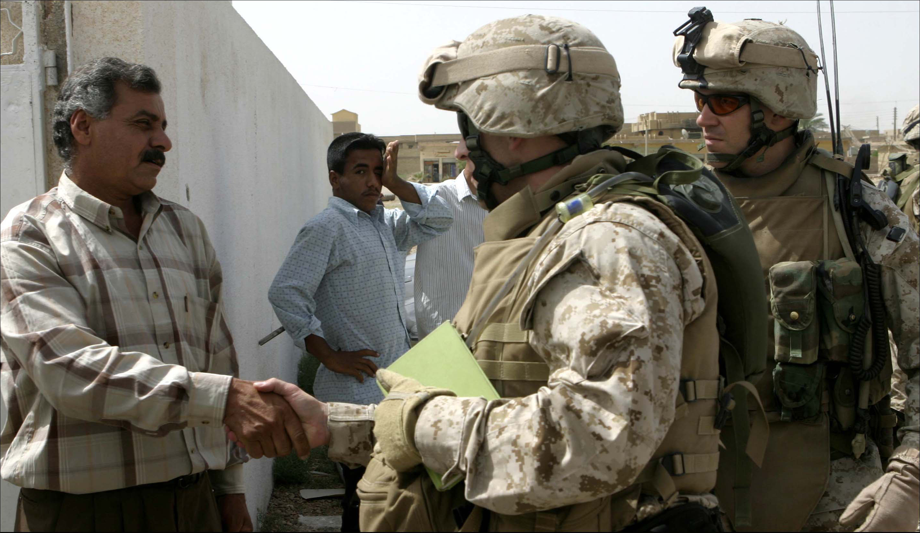
Tact
Maintain good relations – Be courteous and cheerful at all times. Treat others as you would like to be treated.

Slide 16
Tact
Be courteous and cheerful at all times
Check yourself for tolerance and patience
Apply the Gold Rule
Notes:
Apply the Gold Rule
Practice empathy
Practice compassion
How would you want to be treated?
Be friendly
Be helpful
Listen to others
Overcome prejudice
Stop criticism
Do not control others
Be the change

Slide 17

Integrity
Honest and truthful – Be honest and truthful at all times. Have a backbone, stand up for what you believe is right.

Slide 18
Integrity
Be absolute honest and truthful at all times
Stand up for what you believe to be right

Slide 19
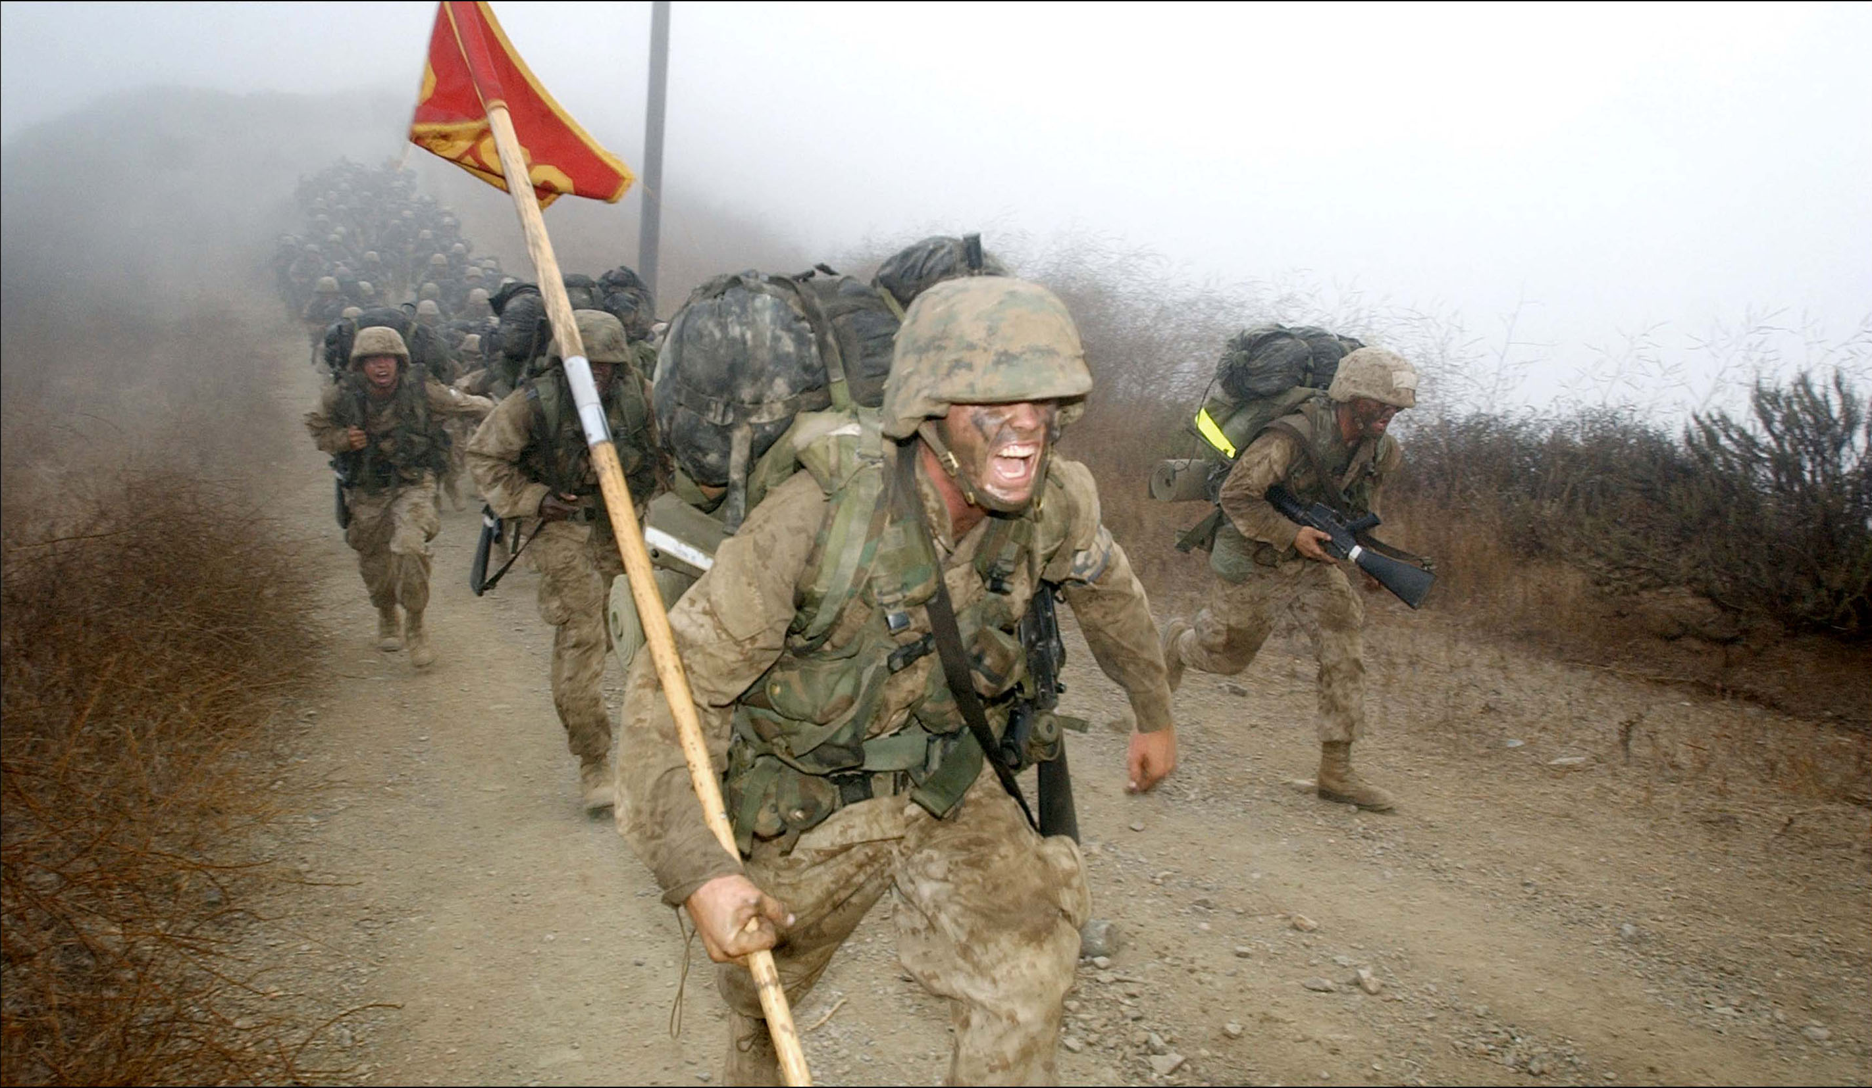
Enthusiasm
Interested and exuberant – You are enthusiastic, optimistic, cheerful, and willing to accept challenges.

Slide 20
Enthusiasm
Consistently exhibit a positive attitude to others
Emphasize your subordinates’ success
Encourage others to overcome any obstacles which they encounter

Slide 21

Bearing
Competent, confident, and in-control – Reach for the top standards of conduct. Just getting by is unacceptable.

Slide 22
Bearing
Hold yourself to the highest standards of personal conduct
Control your voice and gestures
Avoid reprimanding in the presence of others
Avoid profanity or vulgarity

Slide 23

Unselfishness
Considerate – You give credit to those who deserve it and avoid using your authority for personal gain at the expense of others.

Slide 24
Unselfishness
Give credit for job well done
Help your subordinates with the mundane tasks
Avoid using your position for personal gain, safety, or pleasure

Slide 25

Courage
Remain calm while facing fear – Practice self-discipline and calmness. Force yourself to control your reaction to fear.

Slide 26
Courage
Look for and willingly accept responsibilities
Never blame others for your mistakes
Place duty and commitment to mission over personal feelings

Slide 27
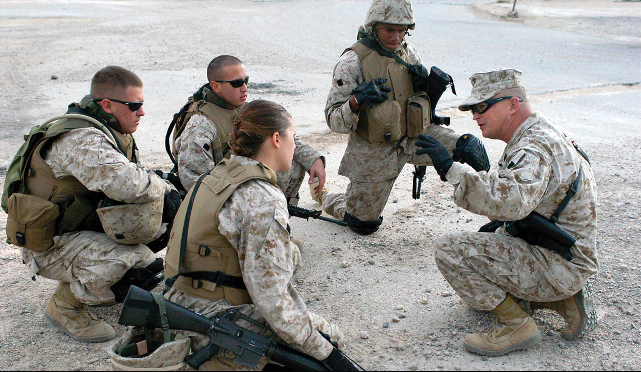
Knowledge
Knowledgeable – Remain alert. Listen, observe, and find out about things you don’t get. Study and stay current!

Slide 28
Knowledge
Increase your knowledge by remaining alert
Ask questions when unsure
Lead by example

Slide 29
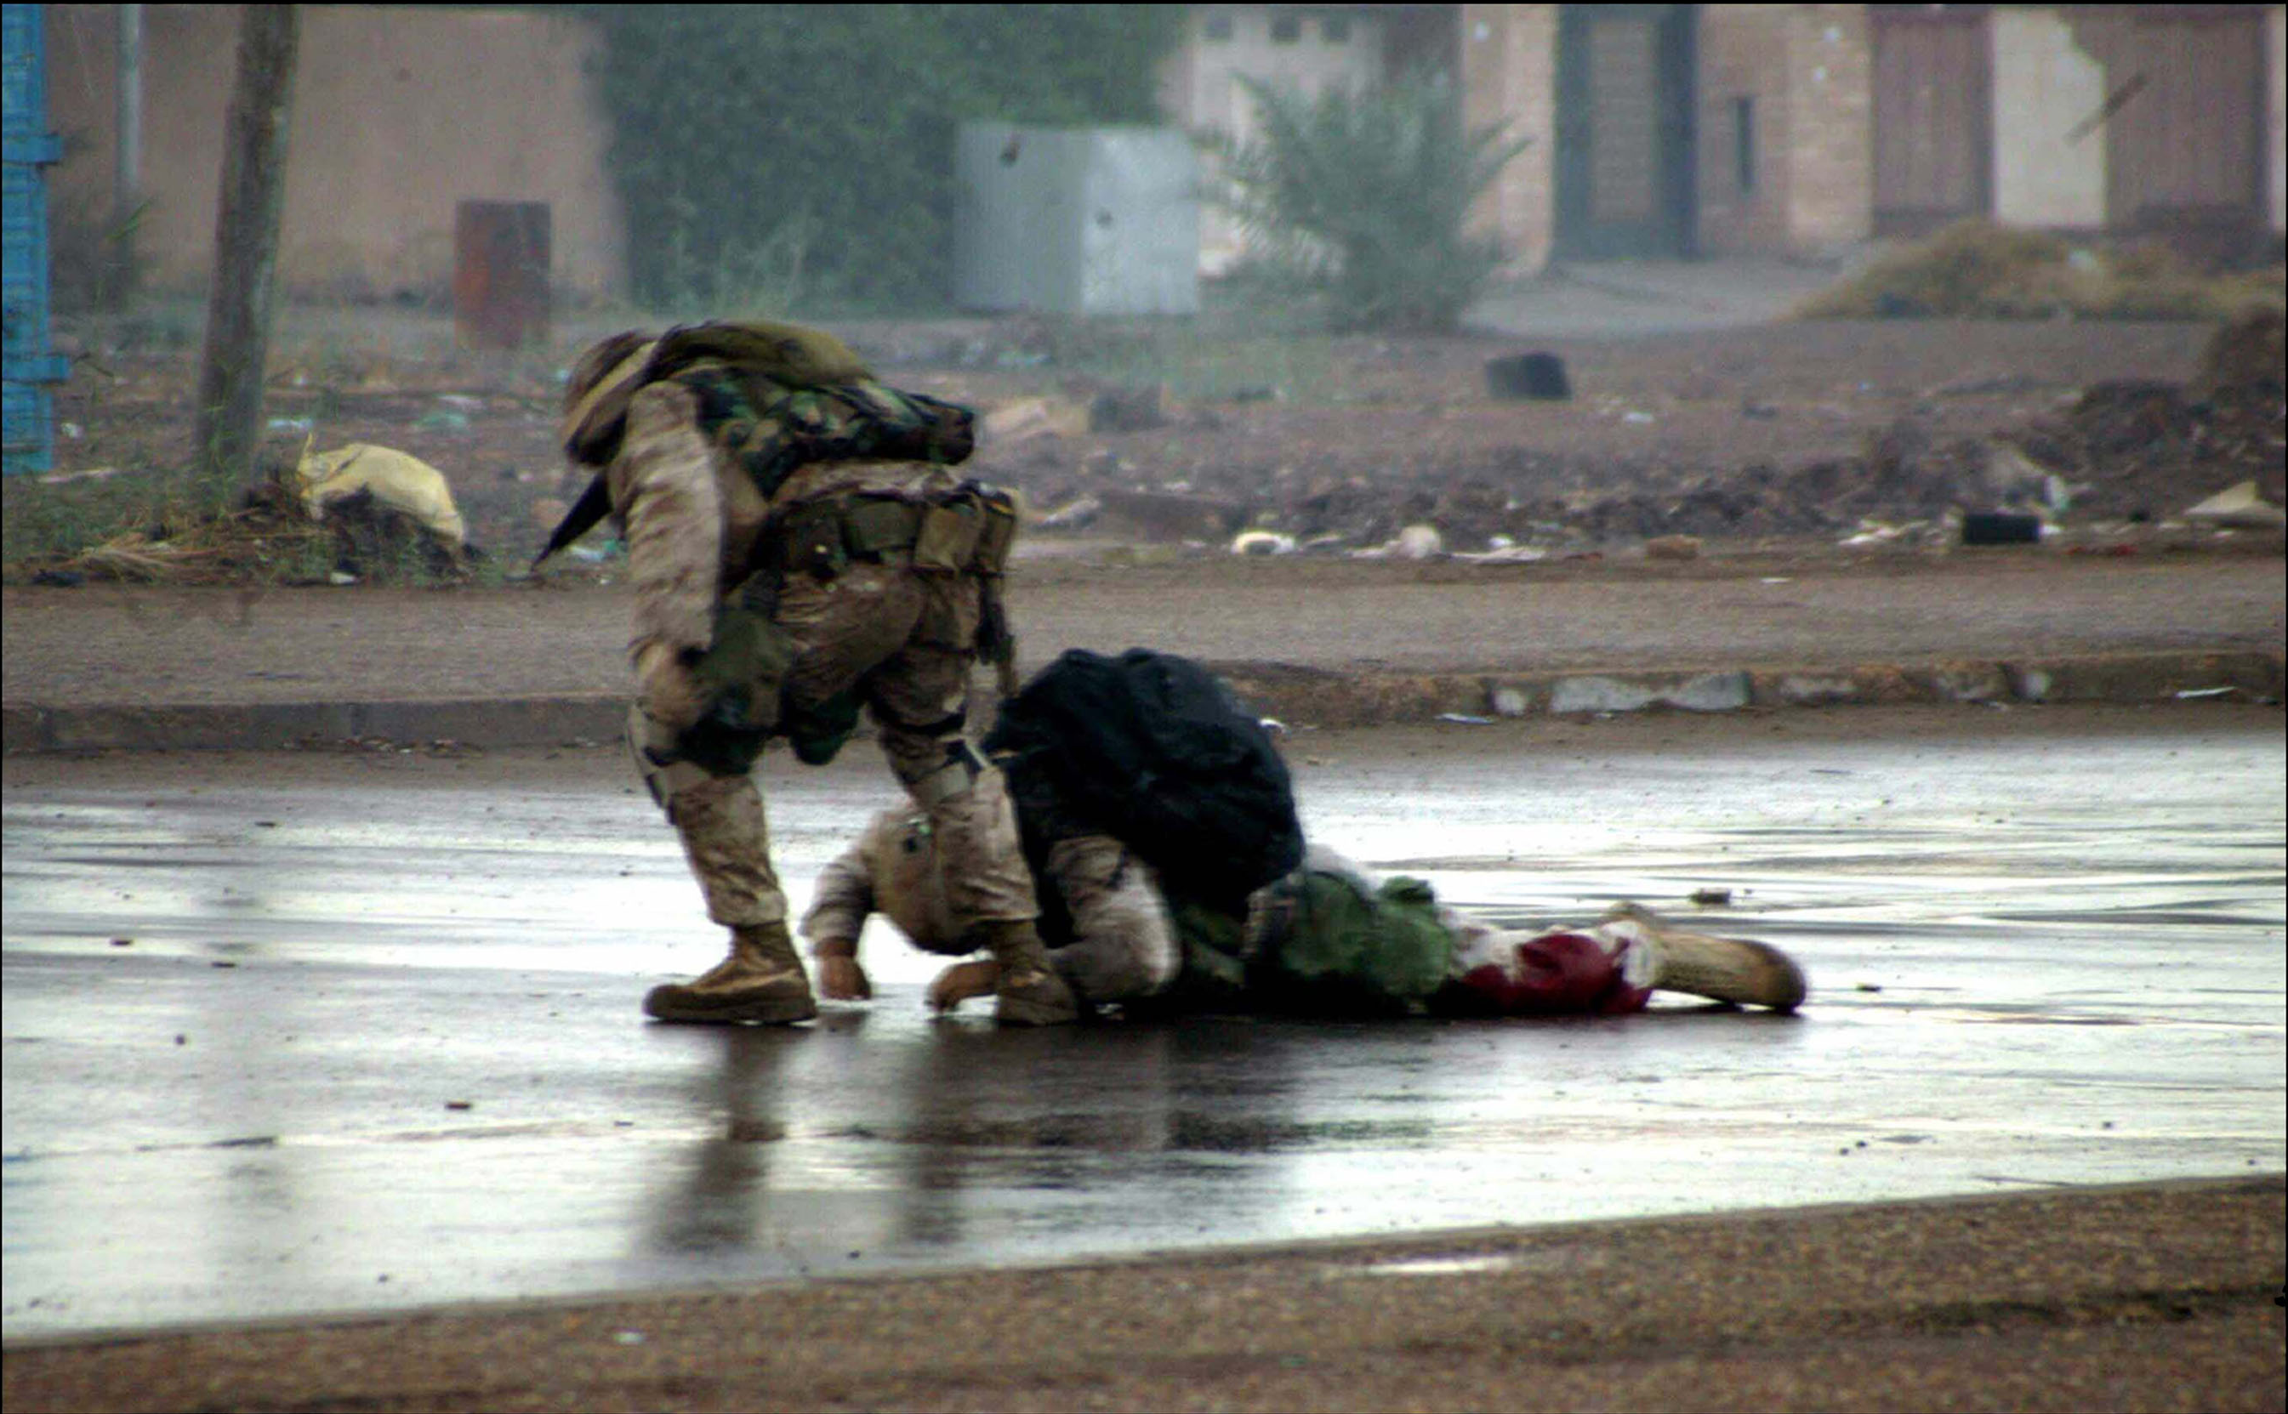
Loyalty
Devoted – Never discuss problems with outsiders. Never talk about seniors unfavorably in front of your subordinates.

Slide 30
Loyalty
Remember that loyalty is a two-way street
Do not gossip
Do not talk unfavorably about your seniors in front of subordinates
Carry out orders as if they were your own
Stand up for your organization

Slide 31

Endurance
Mental and physical stamina– Engage in physical training and finish every task to the best of your ability.

Slide 32
Endurance
Finish every job, regardless of the obstacles
Avoid excesses that lower physical and mental stamina
Maintain a proper diet and exercise

Slide 33
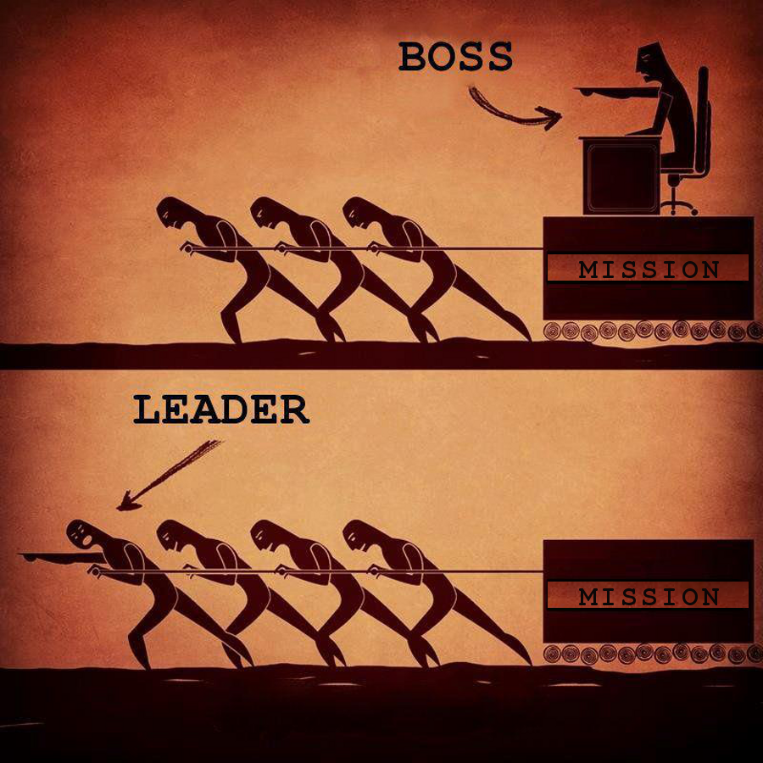

Slide 34
How to be a Leader
Boss
Leader
Drives employees
Depends on authority
Inspires fear
Says, “I”
Places blame for the breakdown
Knows how it is done
Uses people
Takes credit
Commands
Says, “Go”
Coaches them
On goodwill
Generates enthusiasm
Says, “We”
Fixes the breakdowns
Shows how it is done
Develops people
Gives credit
Asks
Says, “Let’s go”

Slide 35

→ chadgreen@chadgreen.com
 chadgreen.com
 @ChadGreen
 ChadwickEGreen

